Slide 1
BioMetrix
By Team R.O.C.K.E.T.
~ Branden Alder, Troy Riblett, JP Fallon, Tanna McClure ~

Slide 2
BioMetrix
Self Health Monitor Android Application represent ongoing changes in their lives for personal or medical use.
BioMetrix gives users a unique ability to track multiple aspects of their health and create custom analytics to represent ongoing changes in their lives for personal or medical use.
Notes:
Scrum Master - Presents this.

Slide 3
What We’ve Done
Medication Module
Graphs
Settings
Basic Analysis
Database sync
Notes:
Scrum Master - Presents this.

Slide 4
Settings, Things, and Stuff
Medication Module Change
The 3 Dots Experience
Module Settings
Individual Module Settings
Notes:
Branden

Slide 5
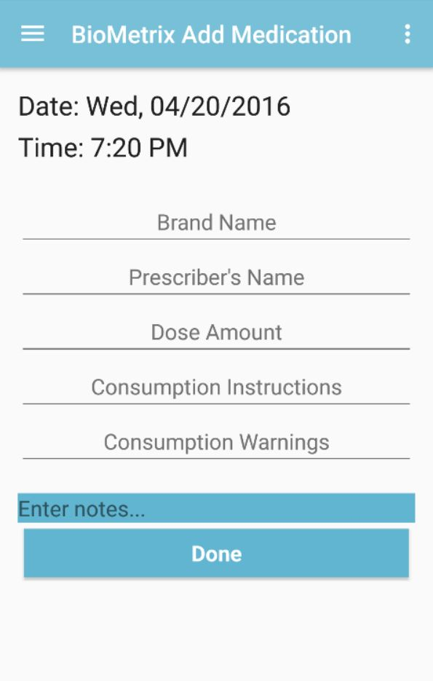
Medication Module Design
Simple Layout
Removed alert and reminder buttons.
Notes:
Branden

Slide 6
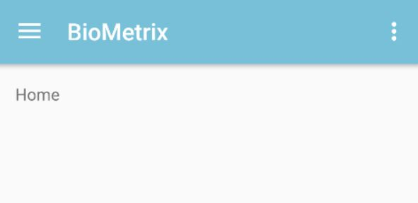
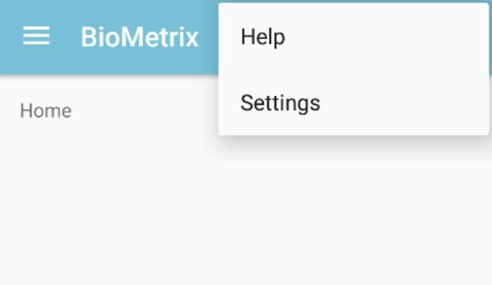
The 3 Dots Experience
Menu area like the navigation drawer up at the top right of phone application.
Menu Options will allow for opening of user assisted options. Ie: Help and Settings
Notes:
Branden

Slide 7
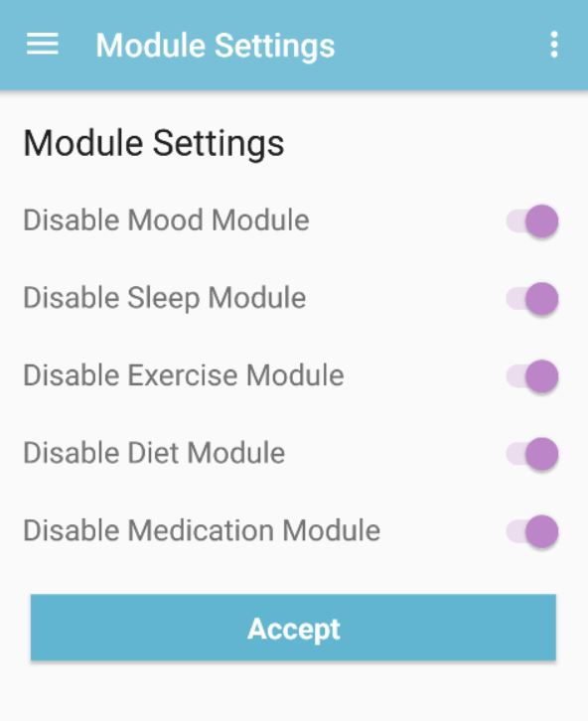
Module Settings
User can enable any module within the navigation drawer.
User can disable any module within the navigation drawer.
Excluding the Analysis Module.
All settings will save to users specific profile (ie: local, login, or google)
Notes:
Branden

Slide 8
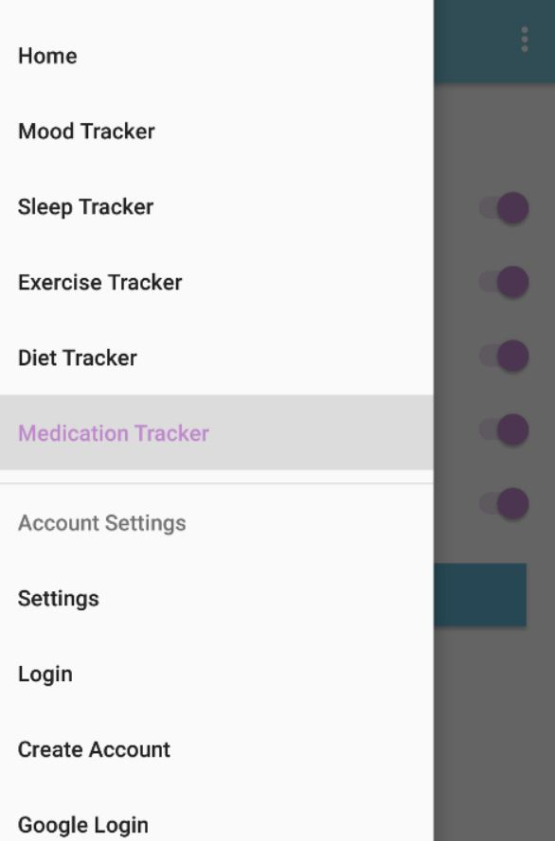
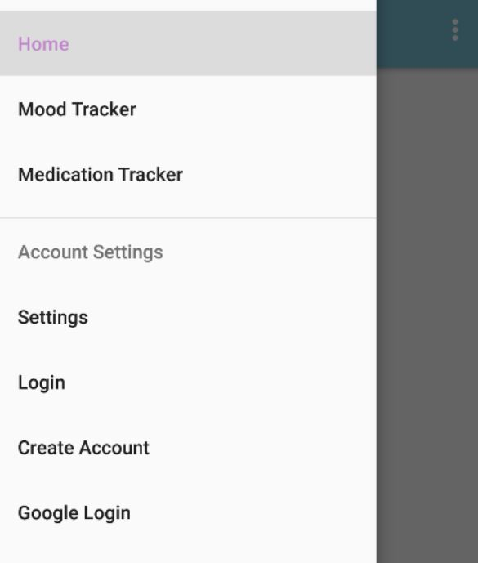
All modules enabled
Three modules disabled
Where current settings are linked.

Slide 9
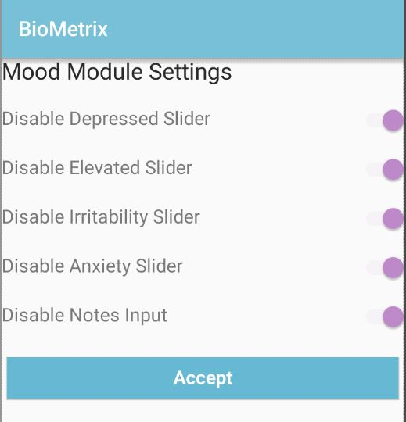
Individual Module Settings
User can enable any item within module.
User can disable any item within module.
All settings will save to users specific profile (ie: local, login, or google)
Notes:
Branden

Slide 10
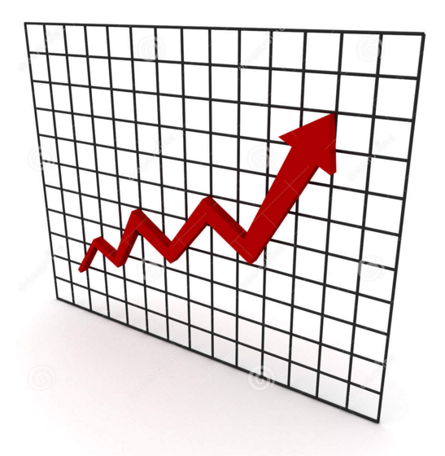
Graphs!
For our analysis we wanted to be able to display graphs for each module
Each module has it’s own graphs
(Diet module coming soon!)

Slide 11
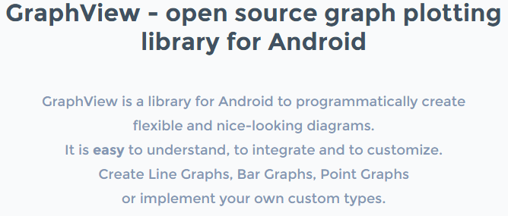

Slide 12
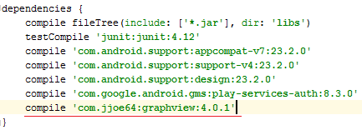
Dependencies
Since we are using Android Studio, adding the library to the project was very simple
Added one line to Build.gradle
The other ways aren’t too bad, but this way is very nice

Slide 13
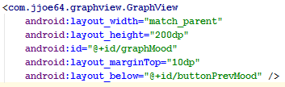
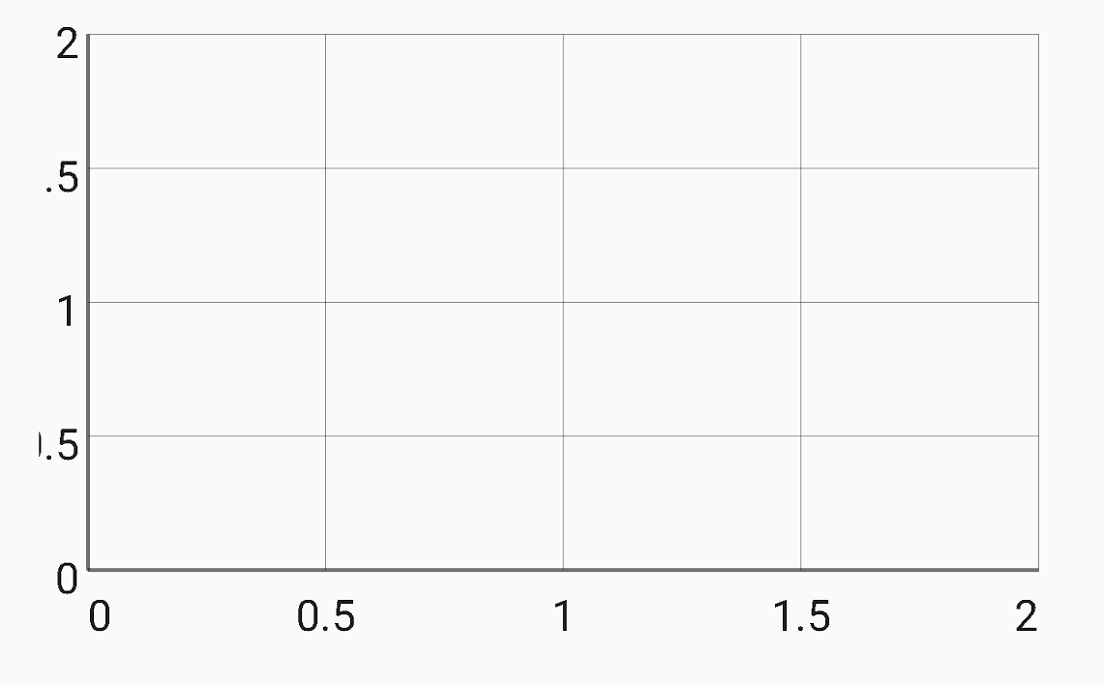
Graph XML
Creates a blank graph
Doing things to the graph happen in the java code

Slide 14
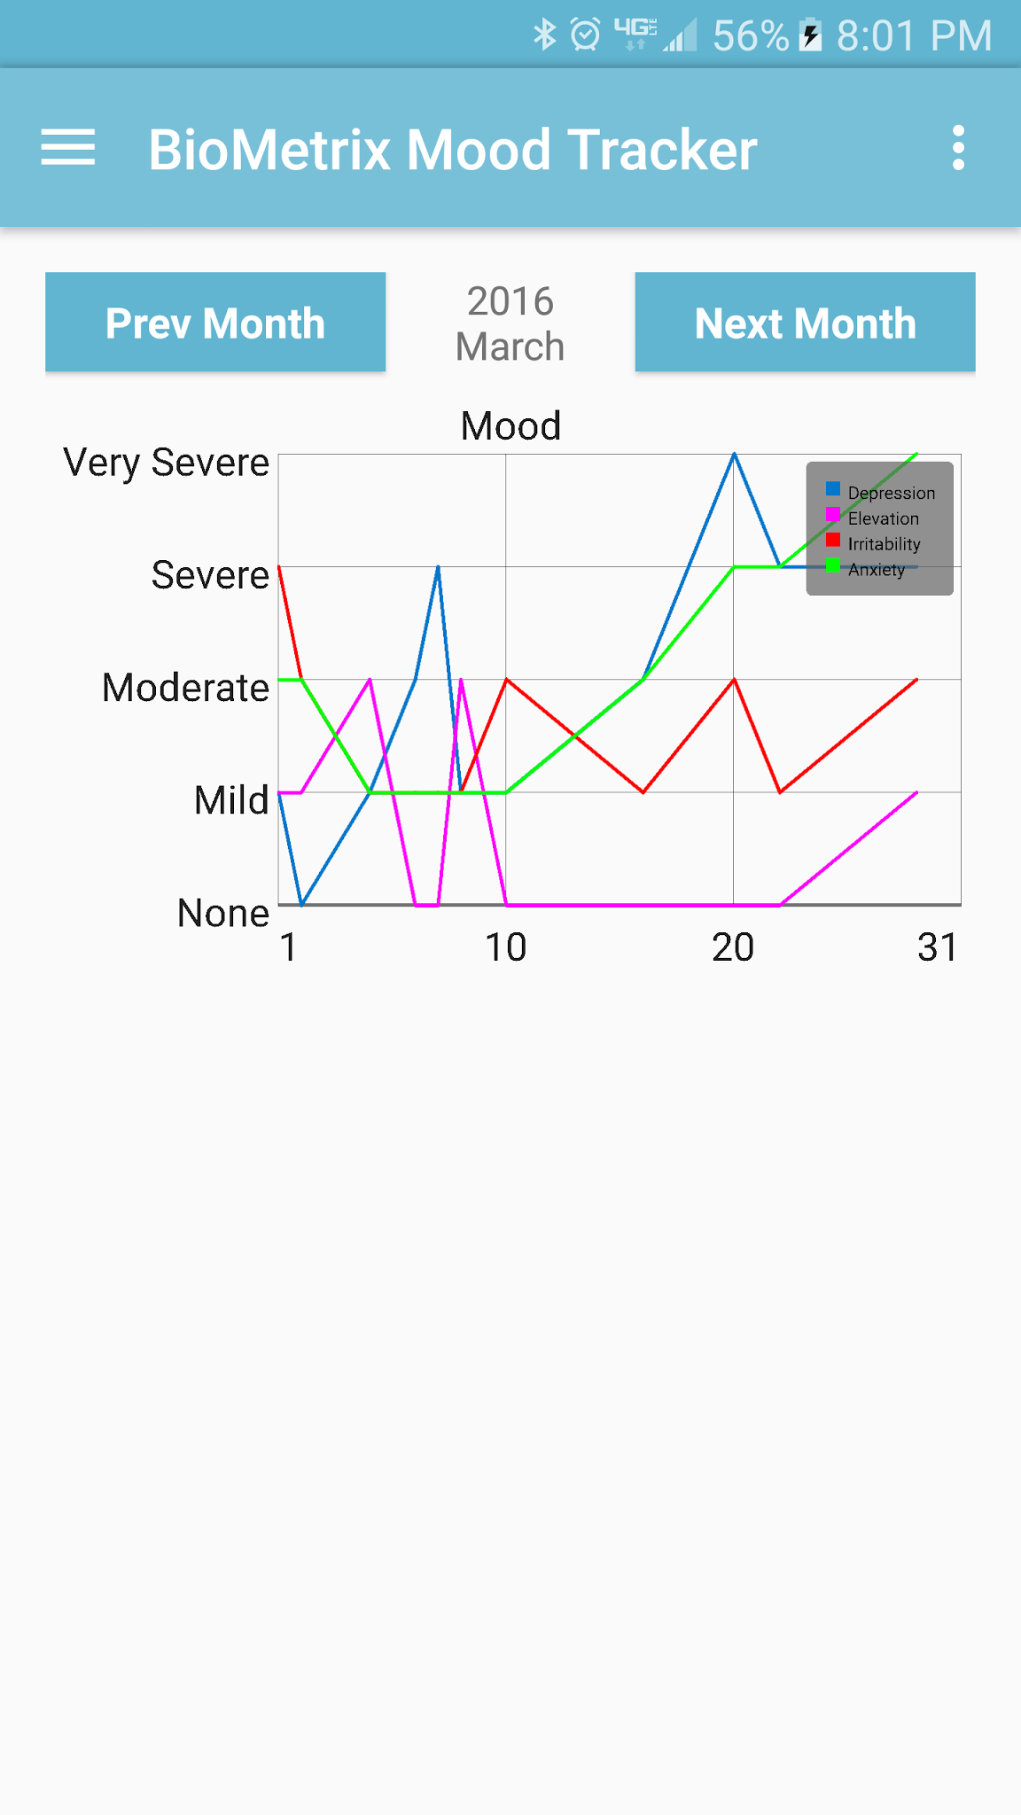
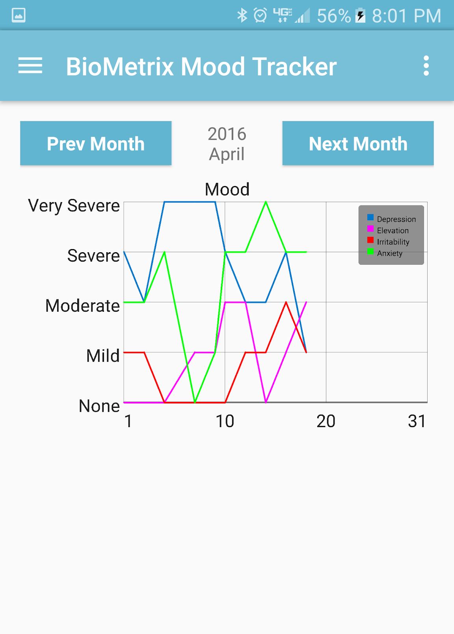
Mood

Slide 15
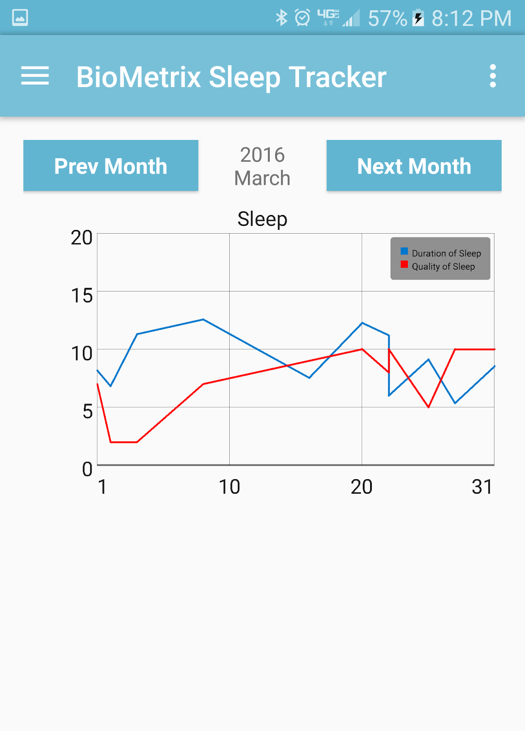

Line Graph
dp.get(1) is a DataPoint[ ]

Slide 16
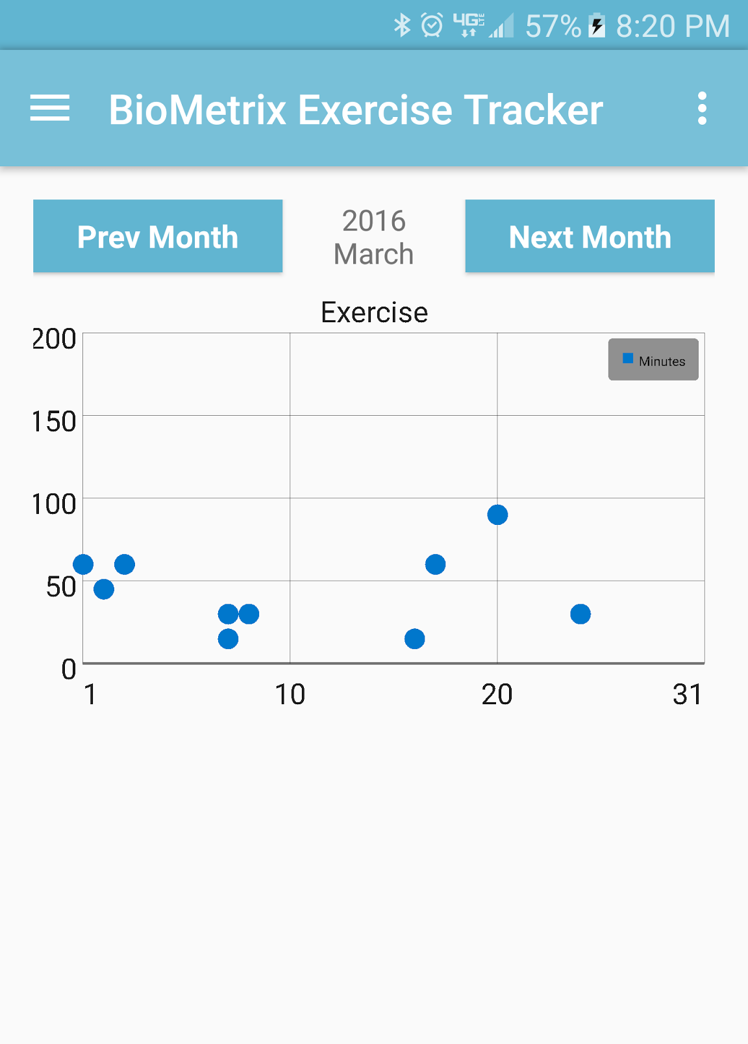

Point Graph

Slide 17
Strings on Axis and Legend
StaticLabelsFormatter
Can set the vertical or horizontal labels
Set titles for each data set
Turn the legend on

Slide 18

Setting Fixed Bounds
Graph automatically sets bounds
X axis is day of the month, so only 1 - 31

Slide 19

Bugs
Managed to find a bug in the library
No data on the graph + fixed bounds = crash

Slide 20
The Culprit

Slide 21
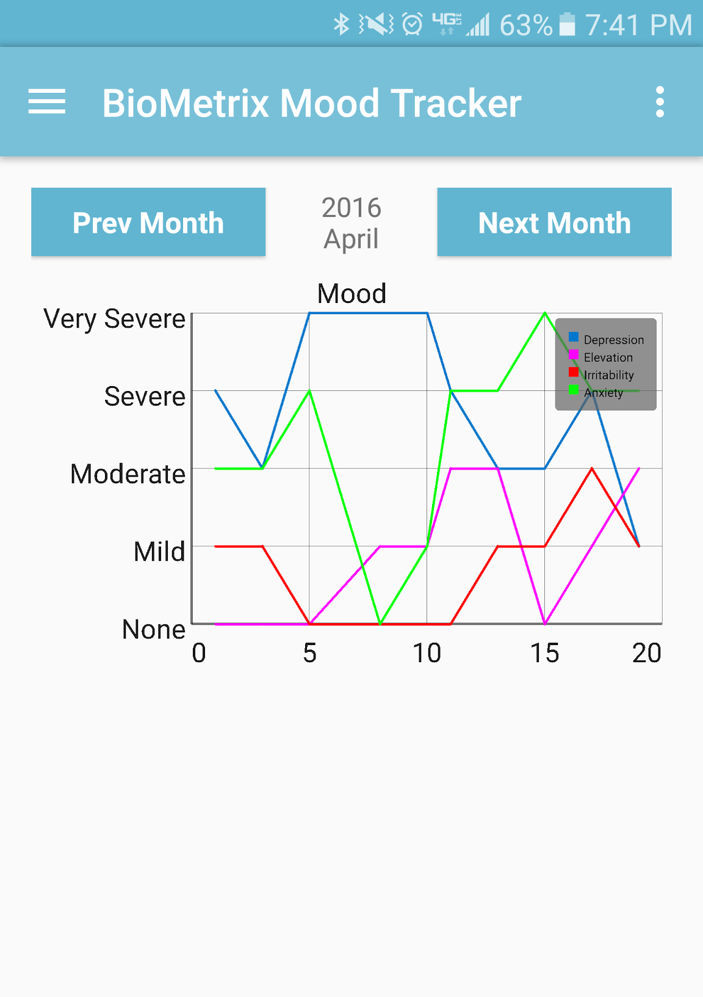

Slide 22
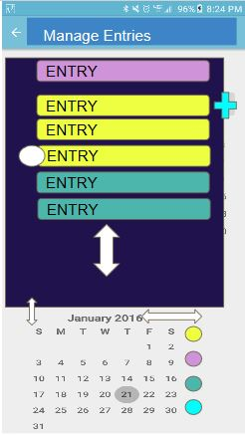
Do You xxxRemember?
Manage Entries
Manage Entries
Manage Entries
Manage Entries

Slide 23
Managing Entries: Genesis
F
RecyclerView
Database
UI Manager
Entry Cards
F
Calendar

Slide 24
Managing Entries: Now
F
RecyclerView
Database
Adapters
UI Managers
Entry Cards
Host Activity
A
F
F
F
Calendar

Slide 25
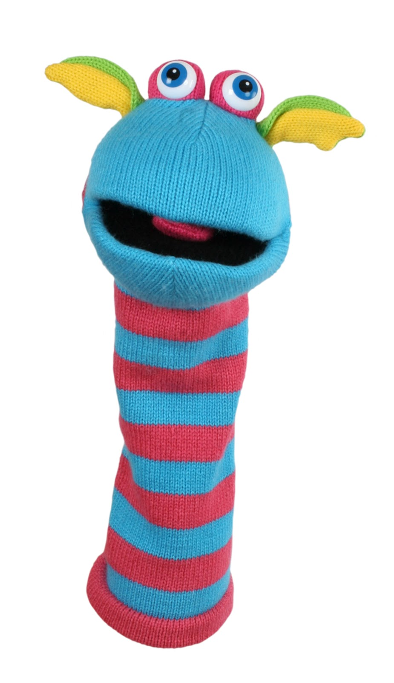
Managing Entries: Now
F
RecyclerView
Database
Adapters
UI Managers
Helper Classes
Entry Cards
Host Activity
A
F
F
F
Calendar

Slide 26

Managing Entries: Now
F
RecyclerView
Database
Adapters
UI Managers
Helper Classes
Entry Cards
Host Activity
A
F
F
F
Calendar
I

Slide 27
Clear as Mud

Slide 28
Managing Entries
Main Thread
RecyclerView
Threads
UI
Calendar Thread
DB

Slide 29
Managing Entries
Main Thread
RecyclerView
Threads
UI
Calendar Thread
DB

Slide 30
Coming up Next: JP’s Going for a Raise
Decorator
Editing entries
Entry cards polish
Calendar filters

Slide 31
Sing along time kids!
I'ma make these suckas recognize
I aint playing yo).
If you violate standard,
Trick you gotta go
I've done held in a lot of sheit
And I'm bout 2 fliyip
Now I think its time 2 show you suckas who you messin’ with
T-JAY
Dats da name,
And I came to bring da pain
‘ode on my chest
Got me bustin at you lemon lames

Slide 32
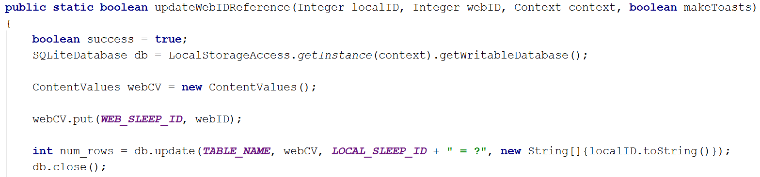
Miscellaneous Items
Recertified HTTPS cert
Updated Insert methods to store webID after completion
Created VBA code to assist with table setup/maintenance

Slide 33
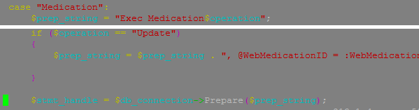

Medication Module Storage
Android code - SQLite
Webserver code - PHP
Database code - SQL

Slide 34
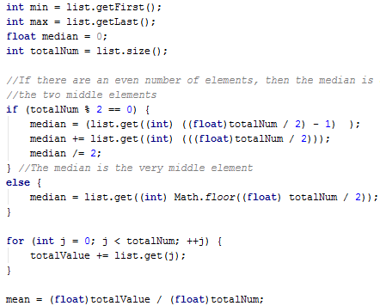
Basic analysis
Pull list of integer fields from SQLite
Statistical type operations on integer fields
Mean, Median, min, max, and count

Slide 35
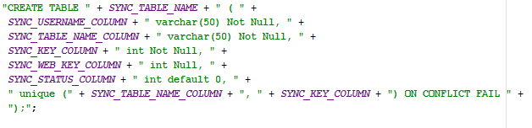
Database Sync Prep
Updated Excel macro and then...
Created code to allow deletions from the webserver
Determined the “Updated” field was insufficient
Replaced with the “Sync” table

Slide 36

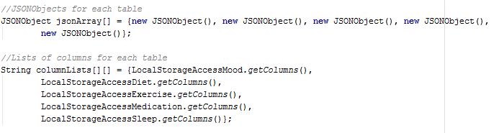
Database Sync - Android Part 1
Grabbing the needed data from the phone
Delete needs key only, update and insert need all
Also need the key for all rows that are not being changed
Storing the data in the phone (temporary structure)
Ended up needing an array of arrays for tables/columns
An array of JSON objects for storing return results

Slide 37
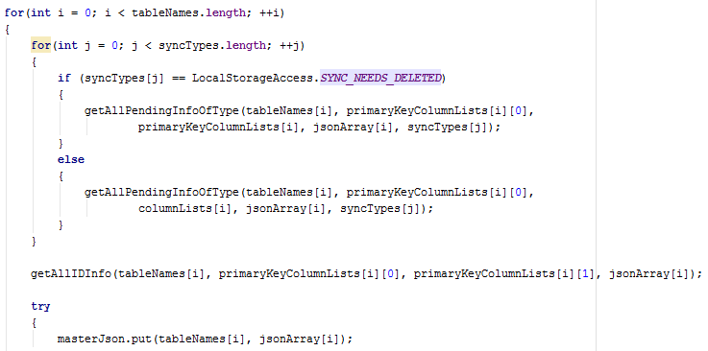
Database Sync - Android Part 2
Lumped data into one JSON object and sent it off

Slide 38
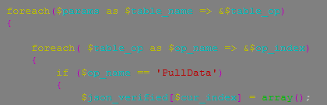
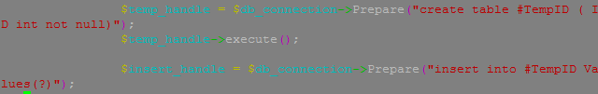
Database Sync - Web Server
Parse the data and call method
Creates a temp table for check method
Create a JSON object and pass it back

Slide 39
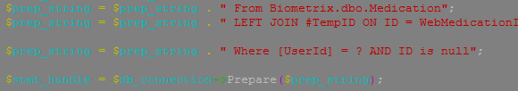
Database Sync - SQL
No additional SQL needed per se
SQL code was written in PHP as prepared statement

Slide 40
Next Sprint
Analysis, analysis, analysis..
Primarily correlations between different fields
Bug fixes
(Login module crashes if done is double-clicked fast enough)
Date and time are stored differently on the webdatabase than the local one.
Notes:
Scrum Master - Presents this.

Slide 41
Demo

Slide 42
Questions?

